Slide 1
Custom Web UI Using Torizon
(or how to build a custom toradex web page in 20 minutes)

Slide 2



Index
Setup
How to access your device via Torizon API
Code
Design / implement your web page
Publish
Launch your web page and make it accessible

Slide 3
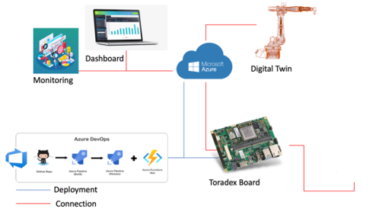
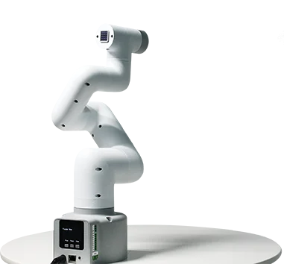
Original Idea
Custom Web UI for any IoT device using Toradex (Erni IoT Showcase)
Carrier Board: Yavia | Família Verdin SoM: NXP i.MX 8M Plus
Torizon OS
Toradex Torizon Platform used for Fleet management and OTA
Controlling 6-axis Robotic Arm myCobot280 from elephantrobotics
Microsoft Azure used for - DevOps - Mqtt Broker - Web Interface - Monitoring

Slide 4
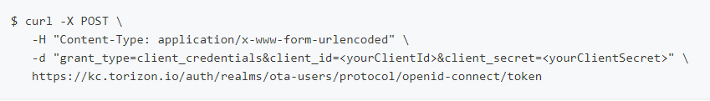
Setup
How to access your device via Torizon API
How-To provision a device (Via Torizon Cloud UI -> https://app.torizon.io/#/ -> Run this command on the device console)
How-To create an API client (Via Torizon Cloud UI -> https://app.torizon.io/#/account -> API Client Manager) (Info: Set the token lifetime here!) (Note that you won't be able to see the secret after closing the form)
How-To get an API token (Request an API token with your ClientId & Client secret)
Check your API accesss
OpenAPI Specification

Slide 5
Code
Implementation - Setup
Our setup - vscode - nodejs (why)
Lets code, follow https://github.com/erni-dan/custom-torizon-ui-talk $ npx express-generator –view=ejs $ npm install axios –save //HTTP Client $ npm install & npm update $ npm start
Check http://localhost:3000/

Slide 6
Code - Recap
Implementation – Access Torizon API via axios HTTP client
Copied https://github.com/erni-dan/custom-torizon-ui/blob/master/torizon_api.js into project and API bearer token into the variable api_bearer_token
Added HTML dependencies to your page https://getbootstrap.com/docs/4.0/getting-started/download/
Got familiar with ejs template engine https://www.digitalocean.com/community/tutorials/how-to-use-ejs-to-template-your-node-application

Slide 7
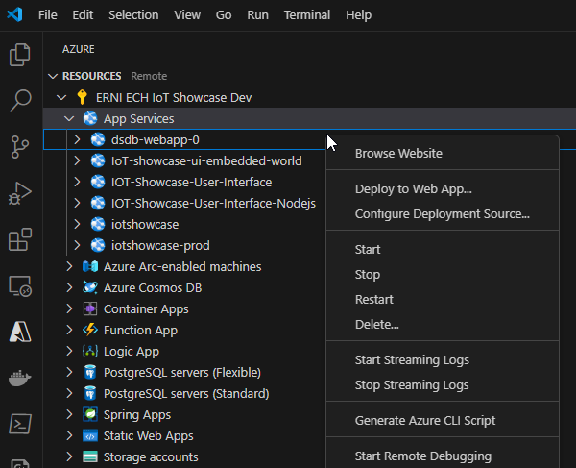
Publish
Launch your web page
Our setup - vscode - Azure Tools extension
Remark: Use extension for deployment only for tests. In Productive environment use your CI/CD pipeline to deploy

Slide 8
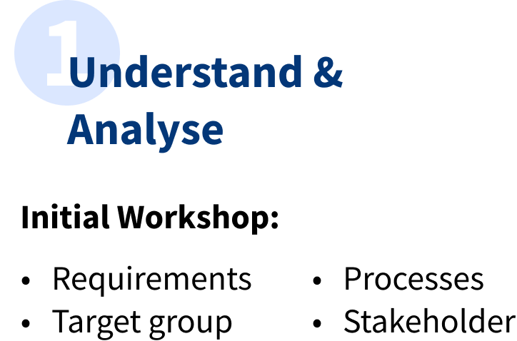
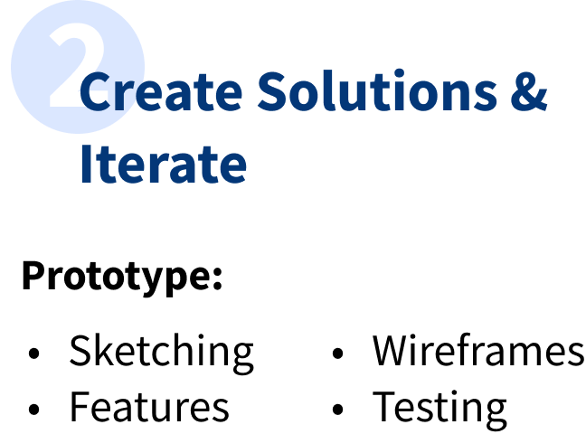

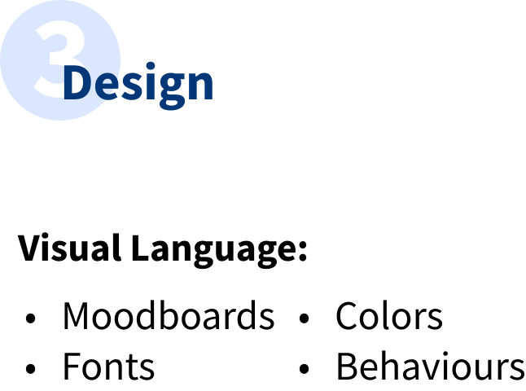



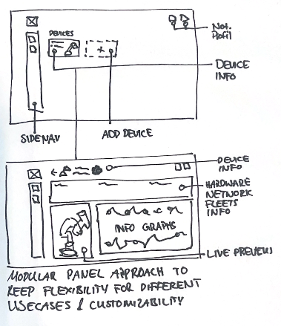
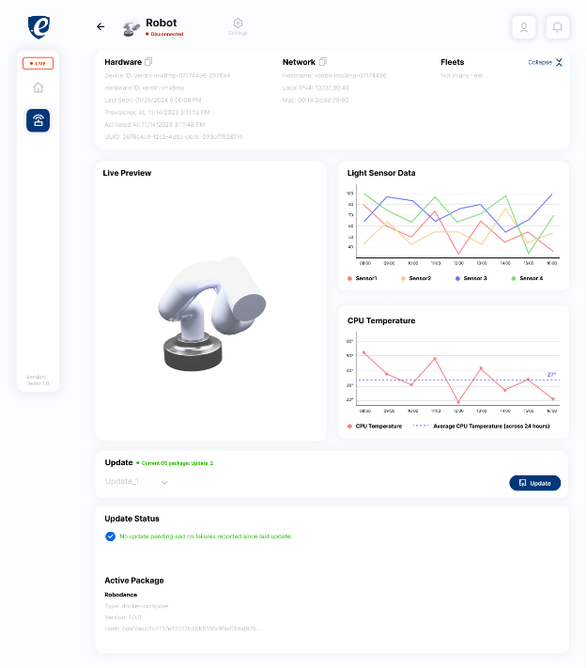
Design
Design your page

Slide 9
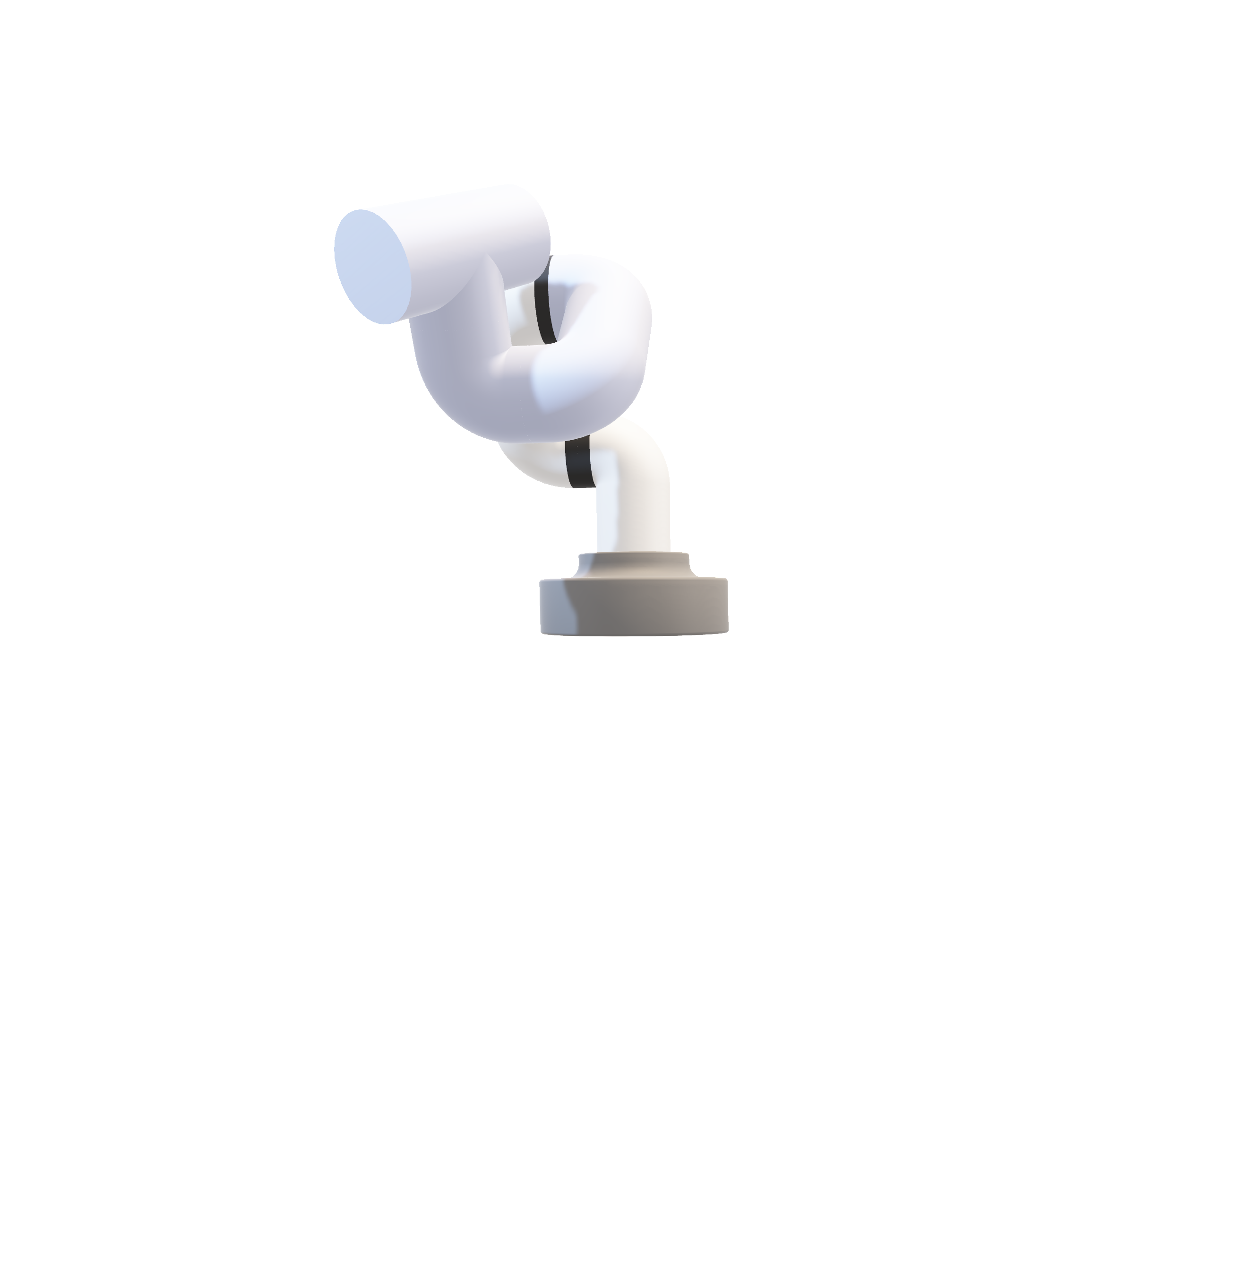
Code
Design your page
Good Experience Design is about:
Building a foundation for good products
Including the User along the way
& being part of every step in the Development process.
Not only about pretty user interfaces

Slide 10
Github Repository
custom-torizon-ui
https://github.com/erni-dan/custom-torizon-ui
Browse Web Page -> https://iot-showcase-ui-embedded-world.azurewebsites.net/
https://github.com/erni-dan/custom-torizon-ui-talk (Presentation + Live Code)

